Slide 1
Retail Giant Sales Forecasting Case Study
By Vatsal Gohel

Slide 2
Global Market Online Supergiant Store
Global Mart Store takes online orders and delivers across the 7 global regions and deals with Consumer, Corporate and home office product categories
Market | Segment
Africa | Consumer
APAC (Asia Pacific) | Corporate
Canada | Home Office
EMEA(Middle East)
EU (European Union)
LATAM (Latin America)
US (United States)

Slide 3
Problem Statement
The store wants to finalize the inventory management plan for the next 6 months. Hence the objective of the analysis are:
Find out the most profitable (and consistent) market segments for the company.
For these segments, forecast the sales and the demand for the next 6 months, so that the revenue and inventory may be managed accordingly
The analysis has been divided into four parts:
Data Understanding
Finding the most profitable segments
Forecasting sales and demand for each of the profitable segments
Recommendations for inventory management

Slide 4
Data Preparation
Understanding the Data
Modelling
Model Evaluation
Create time series of top aggregated data
Smoothen time series to identify trend & Seasonality
Creating a train & validation set of size 42 & 6 months
Build Different Models
Evaluate model on validation set using RMSE & MAPE
Choose Best Model out of all the Models using MAPE
Create 21 Market Segments Buckets
Aggregate buckets by Sales, Profit & Quantity
Perform Train – Test split
Calculate Coefficient of Variation for train Data
Retain only the Market Segment with lowest Cov
Forecasting
Use Best Model to forecast future of 6 month sales for the most profitable Market Segment

Slide 5
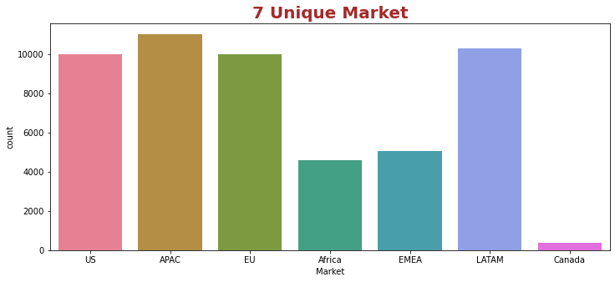
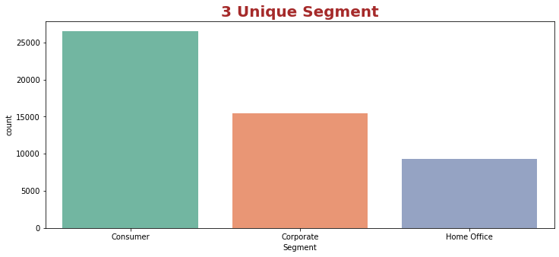
Data Preparation
First, we need to check that there is no missing values present in the data set. In the provided data set, there are no missing values thus no need to impute missing values
Identifying the unique data from the data set
We Can see 3 Segment & 7 market which are unique in the data set
We will visualize the unique columns of segment and market through graph

Slide 6
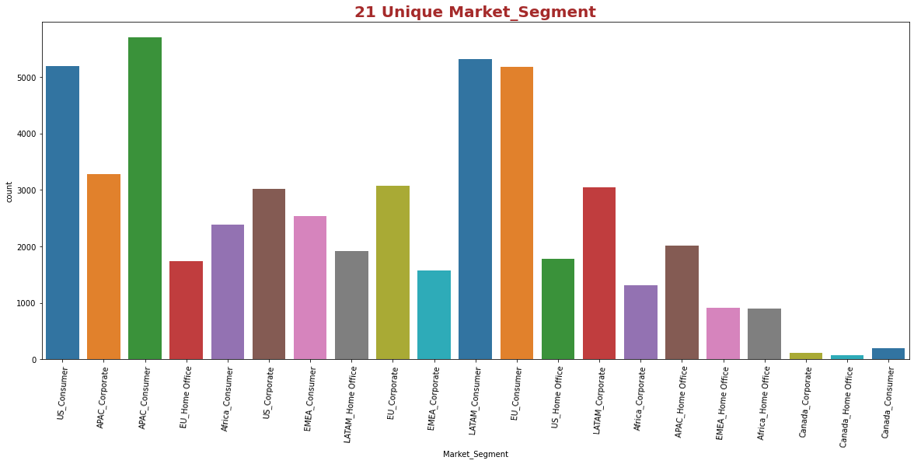
Data Preparation
Preparing an aggregated data with unique market & segment and name it as Market-Segment
After aggregating the data, we will get 21 unique Market Segments
Visualizing the Market Segment through graph
We can see that APAC_Consumer has the highest count

Slide 7
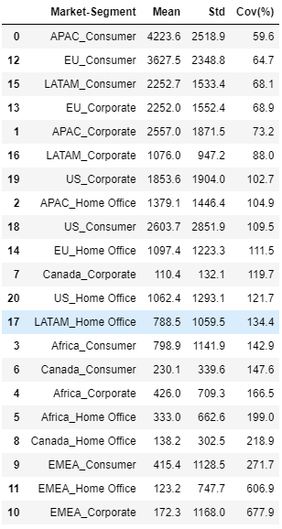
Identifying the most profitable Market-Segment
We get 21 unique Market-Segments after combining both segments and markets
Aggregate the data in each bucket based on Sales, Quantity & Profit
Perform the Train – Test split in the aggregated data
Calculate the CoV on the profit for each of the 21 market segments on the train data
CoV = Standard Deviation / Mean
We want to forecast the sales where the market segment is reliable or in other words, there is less variation in the profits

Slide 8
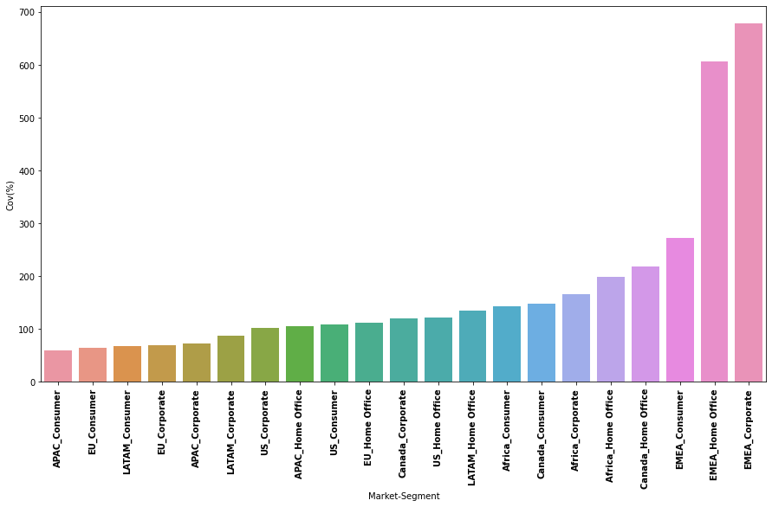
Identifying the most profitable Market-Segment
Plotting the CoV curve to get the better idea
According to data and graph, ‘APAC_Consumer’ has the least CoV of 59.6, which indicates that it is the most stable market segment
As a result, it makes sense to analyze the ‘APAC_Consumer’ market segment

Slide 9
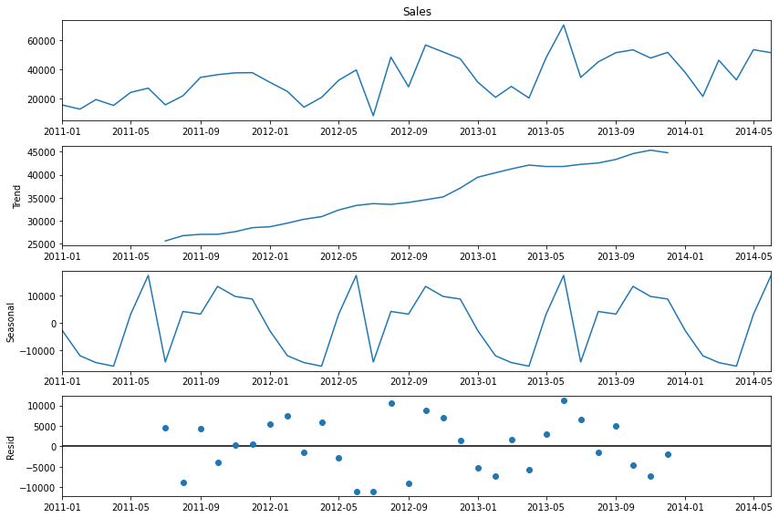
Time Series Decomposition
Lets understand how a time series can be split into its various components that is the Trend, Seasonality, and Residuals
Seasonal Decomposition of ‘APAC_Consumer’ Sales Data (Additive)
Decomposed the data using the additive method:
We can see the clear upward trend and some seasonality as well in the graph
The residuals seem to have some pattern

Slide 10
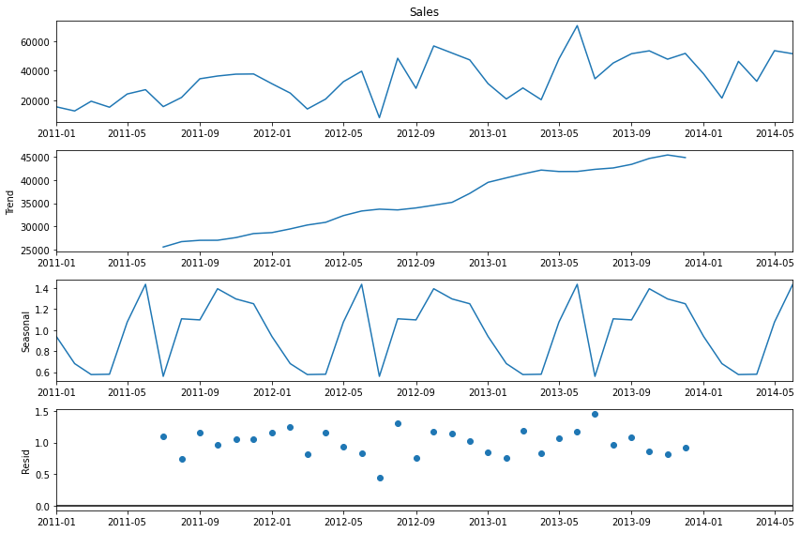
Time Series Decomposition
Seasonal Decomposition of ‘APAC_Consumer’ Sales Data (Multiplicative)
Decomposed the data using the multiplicative method:
we can see that the trend is again having the upward movement
A certain pattern can be sensed in seasonality, and residuals seem to have been disrupted a little bit

Slide 11
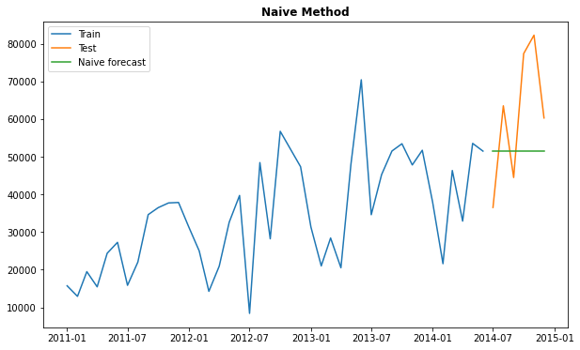

Building and Evaluating Time Series Forecasts
Simple time series methods
Time Series Model – Naïve Method:

Slide 12
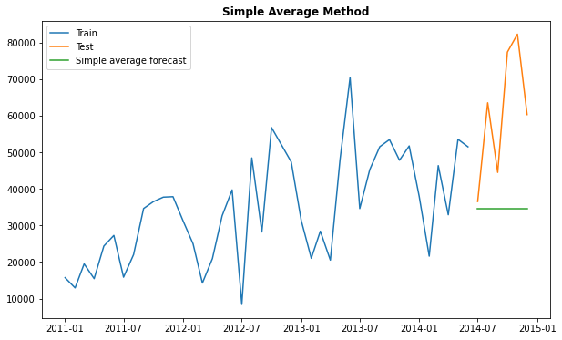
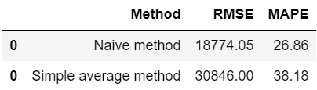
Building and Evaluating Time Series Forecasts
Simple time series methods
Time Series Model – Simple Average Method:

Slide 13
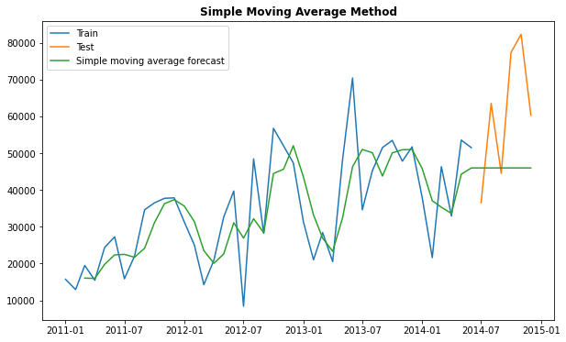
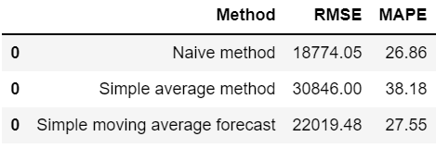
Building and Evaluating Time Series Forecasts
Simple time series methods
Time Series Model – Simple Moving Average Method:

Slide 14
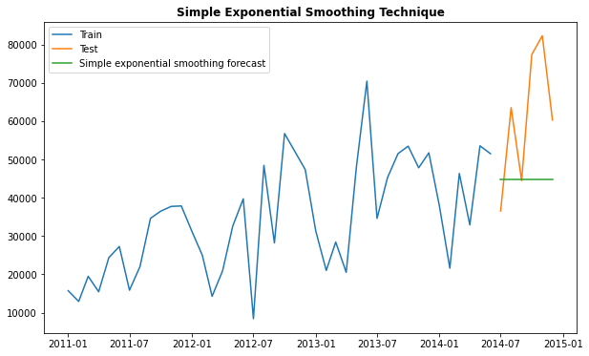
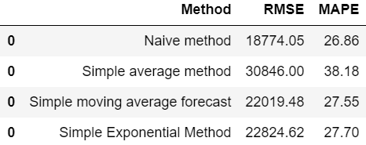
Building and Evaluating Time Series Forecasts
Smoothing Techniques
Time Series Model – Simple Exponential Smoothing:

Slide 15
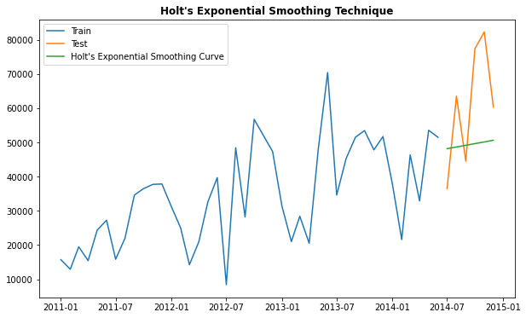
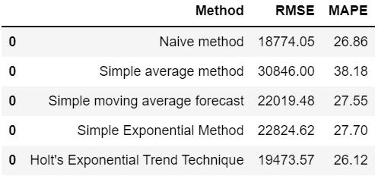
Building and Evaluating Time Series Forecasts
Smoothing Techniques
Time Series Model – Holt's Exponential Smoothing:

Slide 16
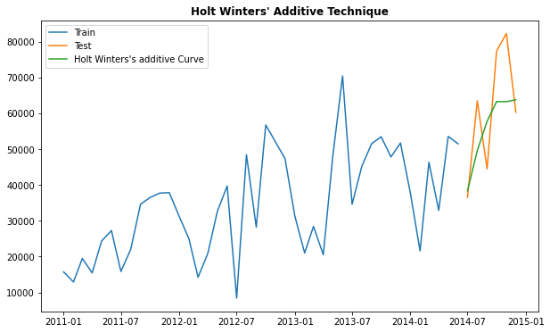
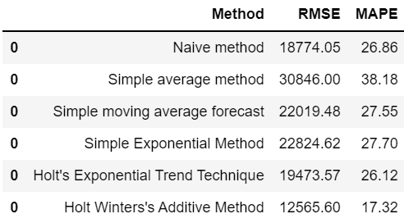
Building and Evaluating Time Series Forecasts
Smoothing Techniques
Time Series Model – Holt Winters' additive method:

Slide 17

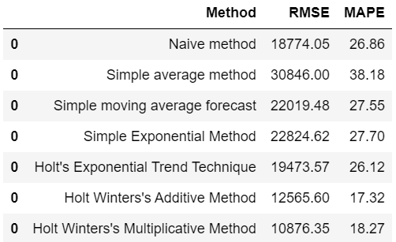
Building and Evaluating Time Series Forecasts
Smoothing Techniques
Time Series Model – Holt Winters' multiplicative method:

Slide 18
Building and Evaluating Time Series Forecasts
Auto Regressive methods
First we need to check whether the time series is stationary or Non-Stationary
If the Time-Series is not Stationary, we need to transform it in order to make it Stationary
Two statistical tests, namely ADF and KPSS, will be performed in order to validate the Stationarity of the Time Series
Augmented Dickey-Fuller (ADF) Test:
Null Hypothesis (𝐻0): The series is not stationary 𝑝−𝑣𝑎𝑙𝑢𝑒 > 0.05
Alternate Hypothesis (𝐻1): The series is stationary 𝑝−𝑣𝑎𝑙𝑢𝑒 <= 0.05
Kwiatkowski-Phillips-Schmidt-Shin (KPSS) Test:
Null Hypothesis (𝐻0): The series is stationary 𝑝−𝑣𝑎𝑙𝑢𝑒 > 0.05
Alternate Hypothesis (𝐻1): The series is not stationary 𝑝−𝑣𝑎𝑙𝑢𝑒 <= 0.05

Slide 19
Building and Evaluating Time Series Forecasts
Auto Regressive methods
Augmented Dickey-Fuller (ADF) Test:
By performing the test we get the p-value of 0.19 which is greater than 0.05 so we will go with the Null Hypothesis that the series is not stationary
Kwiatkowski-Phillips-Schmidt-Shin (KPSS) Test:
By performing the test we get the p-value of 0.023 which is less than 0.05 thus the Null Hypothesis that is the series is stationary gets rejected
To make the dataset stationary and suitable for Auto Regression Models, we need to take necessary steps such as differencing and Box Cox Transformation

Slide 20
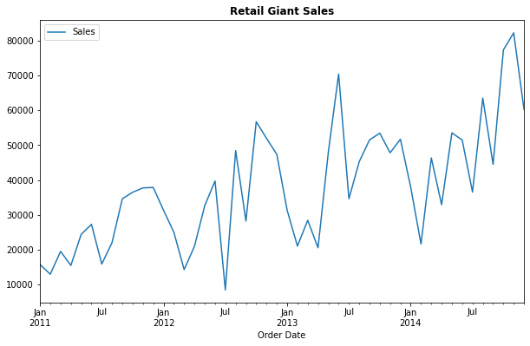
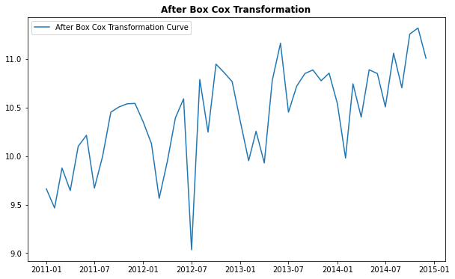
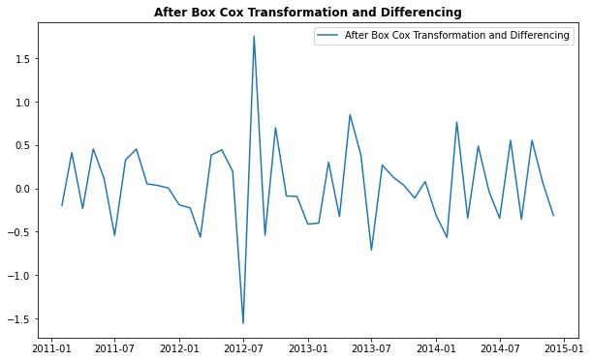
Building and Evaluating Time Series Forecasts
Auto Regressive methods
Box Cox Transformation & Differencing
To make the Non-Stationary data into Stationary data

Slide 21
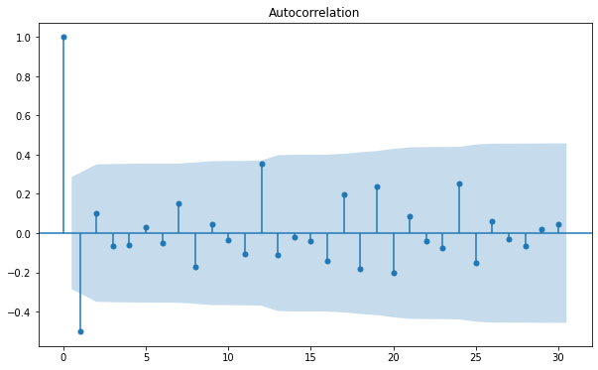
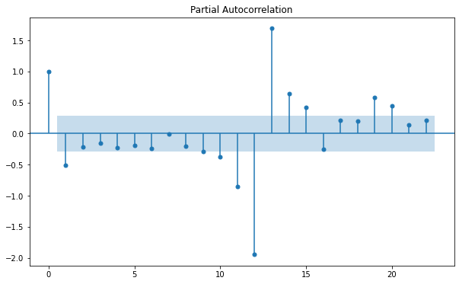
Building and Evaluating Time Series Forecasts
Auto Regressive methods
Autocorrelation Function (ACF) & Partial Autocorrelation (PACF) Plot
From ACF plot we could see the dependency on the very next node which means MA should be 1
From PACF plot we could see there is a seasonality in the data

Slide 22

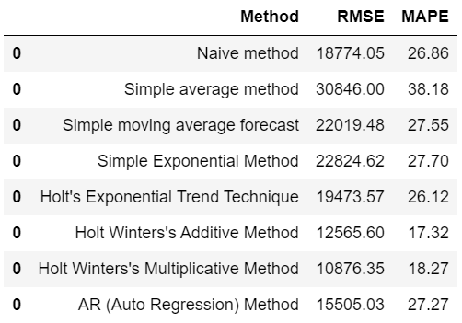
Building and Evaluating Time Series Forecasts
Auto Regressive methods
Time Series Model – Auto Regression (AR) Method:

Slide 23
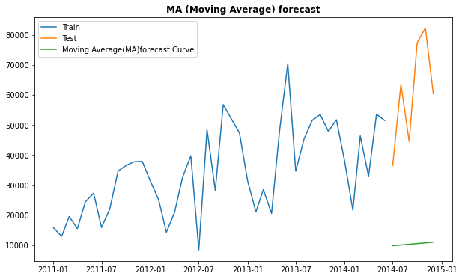
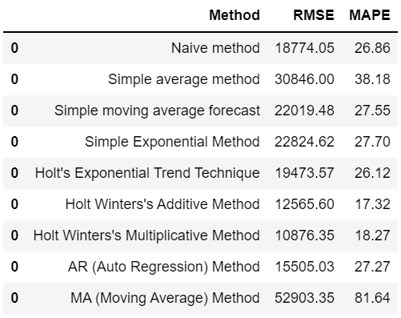
Building and Evaluating Time Series Forecasts
Auto Regressive methods
Time Series Model – Moving Average (MA) Method:

Slide 24
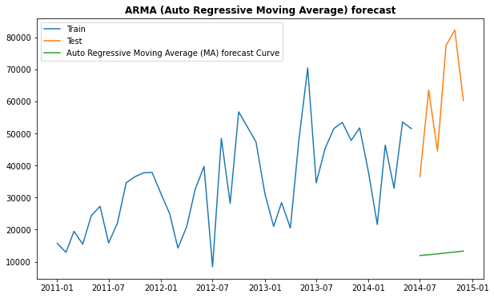
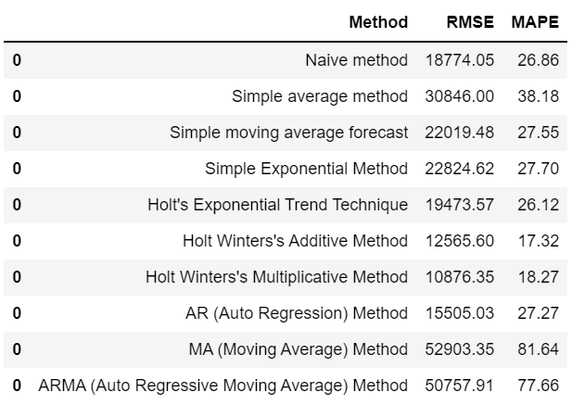
Building and Evaluating Time Series Forecasts
Auto Regressive methods
Time Series Model – Auto Regressive Moving Average (ARMA) Model:

Slide 25
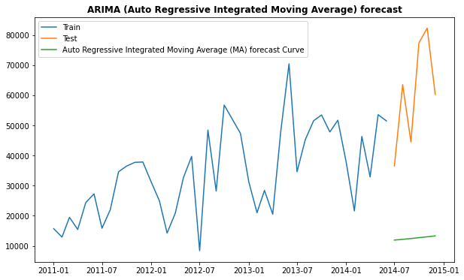
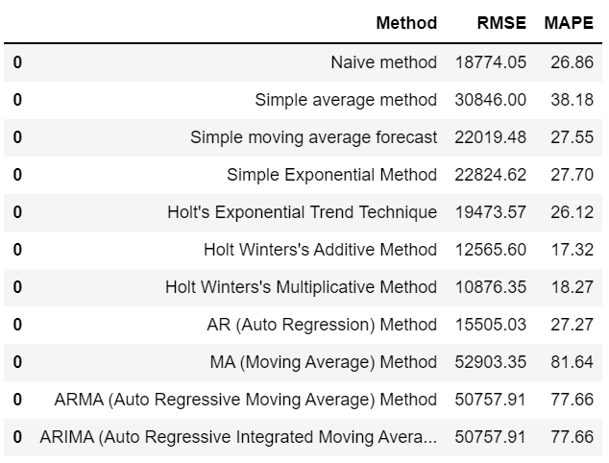
Building and Evaluating Time Series Forecasts
Auto Regressive methods
Time Series Model – Auto Regressive Integrated Moving Average (ARIMA) Model:

Slide 26
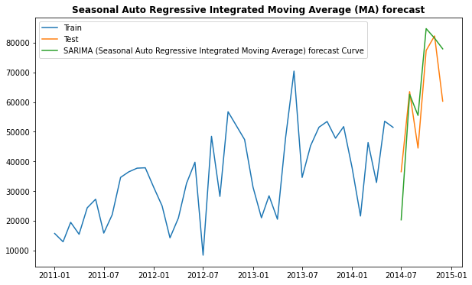
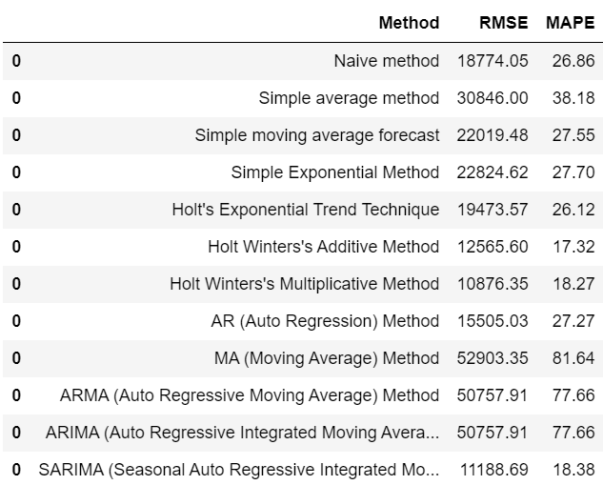
Building and Evaluating Time Series Forecasts
Auto Regressive methods
Time Series Model – Seasonal Auto Regressive Integrated Moving Average (SARIMA) Model:

Slide 27
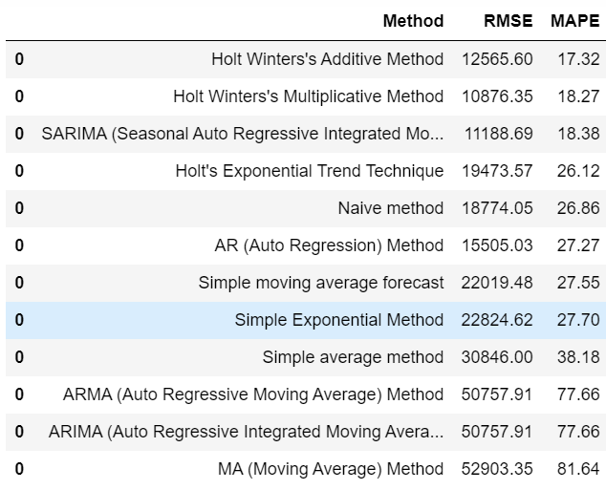
Model Evaluation Based on MAPE
The best performing time series model is Holt Winters’ Additive Method out of 12 time series models

Slide 28
Conclusion
We were able to help the Global Market identify the most popular market segment named ‘APAC_Consumer’ based on the data provided
There are 12 different forecasting models designed for the 'APAC_Consumer' market segment
Holt Winters’ Additive Method is the most accurate forecasting method among smoothing methods
Forecasting accuracy is best achieved with Seasonal Autoregressive Integrated Moving Average (SARIMA) among the ARIMA set of techniques
Analyzing the plot enabled us to realize that sales have a trend and a seasonality. Unlike other models which allow us to choose between the two, Holt Winter's and SARIMA allows to capture both
Additionally, a time series of sales data may have some sort of seasonality associated with it since the sales of any item will not remain the same throughout the given period, usually a year. There may also be a positive or negative trend associated with it
For this reason, Holt Winter's models and SARIMA models are the best sales forecasting models

